Slide 1
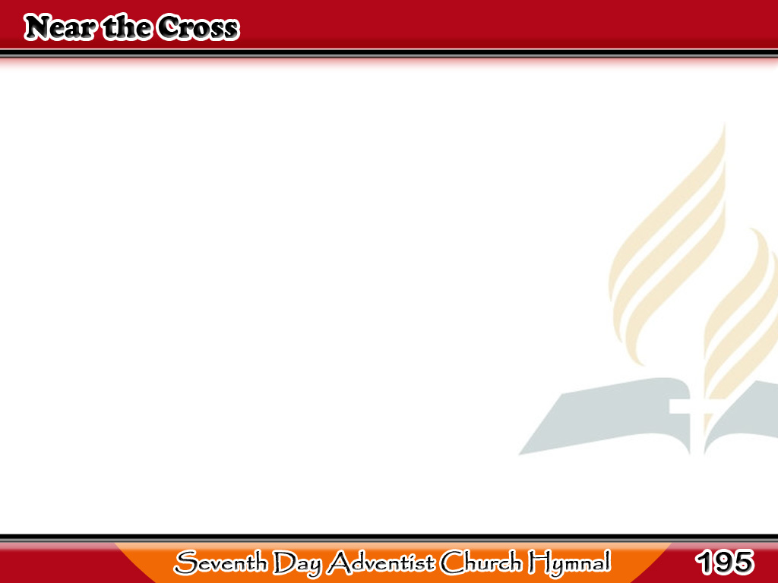
Ako’y Ilapit sa Krus
Jesus, keep me near the cross;
There a precious fountain
Free to all, a healing stream,
Flows from Calvary’s mountain.
1/4

Slide 2
Ako’y Ilapit sa Krus
-Refrain-
In the cross, in the cross,
Be my glory ever,
Till my raptured soul shall find
Rest beyond the river.
1/4

Slide 3
Ako’y Ilapit sa Krus
Near the cross, a trembling soul,
Love and mercy found me;
There the bright and Morning Star
Sheds its beams around me.
2/4

Slide 4
Ako’y Ilapit sa Krus
-Refrain-
In the cross, in the cross,
Be my glory ever,
Till my raptured soul shall find
Rest beyond the river.
2/4

Slide 5
Ako’y Ilapit sa Krus
Near the cross! O Lamb of God,
Bring its scenes before me;
Help me walk from day to day,
With its shadows o’er me.
3/4

Slide 6
Ako’y Ilapit sa Krus
-Refrain-
In the cross, in the cross,
Be my glory ever,
Till my raptured soul shall find
Rest beyond the river.
3/4

Slide 7
Ako’y Ilapit sa Krus
Near the cross I’ll watch and wait,
Hoping, trusting ever,
Till I reach the golden strand,
Just beyond the river.
4/4

Slide 8
Ako’y Ilapit sa Krus
-Refrain-
In the cross, in the cross,
Be my glory ever,
Till my raptured soul shall find
Rest beyond the river.
4/4

